Slide 1
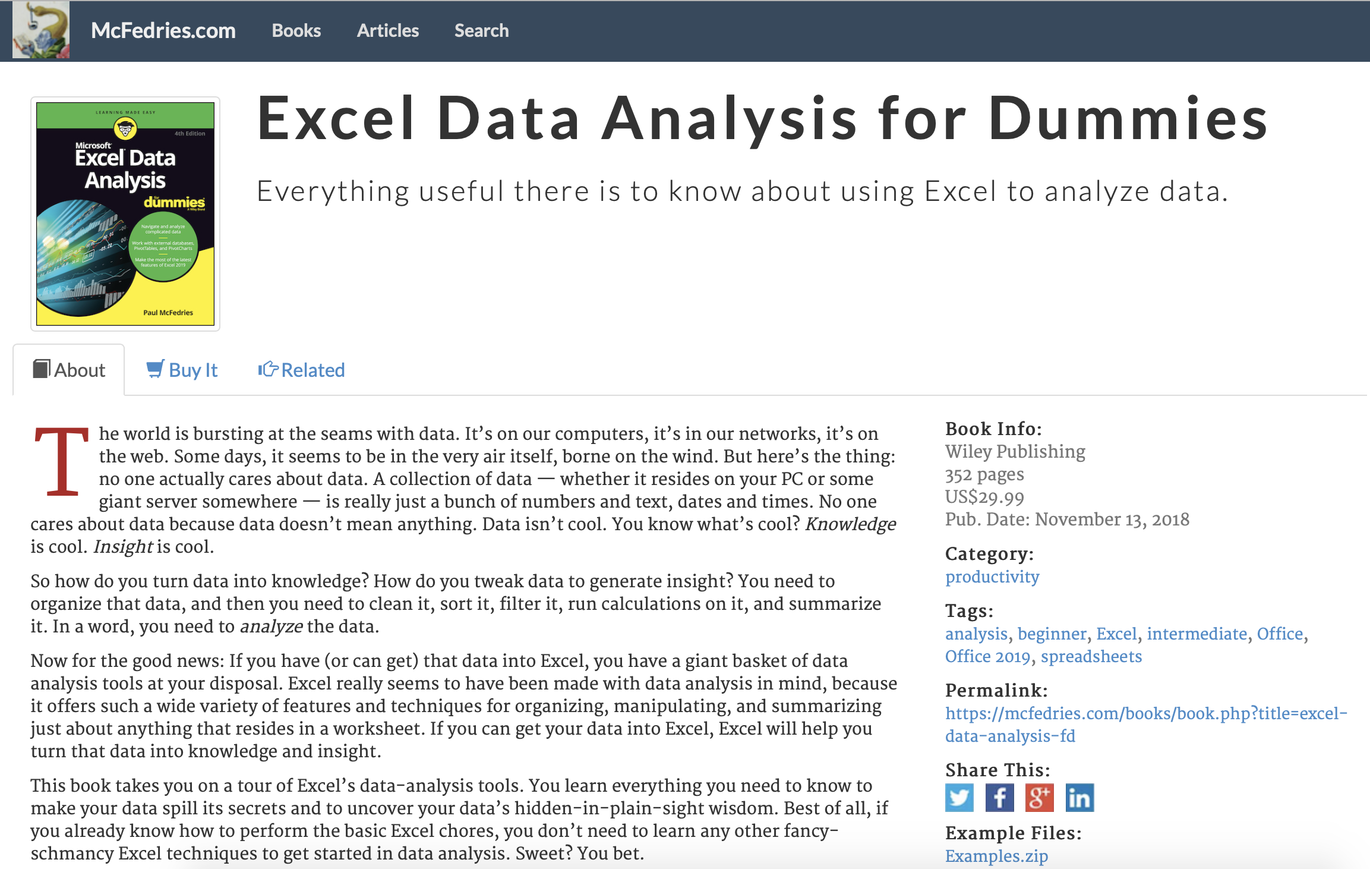
Excel Data Analysis for dummies
Studying Note
https://www.mcfedries.com/books/book.php?title=excel-data-analysis-fd
Click here to download the practice data

Slide 2
Shortcut key
Command + shift + arrow
Function
= SUMIF(A1:A10,”User”,B1:B10)
= IF(logical_test, [value_if_true], [value_if_false])
= IF(A1<10, “low”, IF(A1<20, “middle”, “high”))
= VLOOKUP(lookup_value, table_array, col_index_num, False/True) 精确/模糊
= HLOOKUP(lookup_value, table_array, row_index_num, False/True) 精确/模糊
= RANDBETWEEN(1,4)

Slide 3
Chapter 1 Learning Basic Data-analysis Techniques
Analyzing Data with Conditional Formatting
Highlighting cells that meet some criteria
Showing pesky duplicate values
Highlighting the top or bottom values in a range
Analyzing cell values with data bars
Analyzing cell values with color scales
Analyzing cell values with icon sets
Summarizing Data with Subtotals
Grouping Related Data
Consolidating Data from Multiple Worksheets (Combining multiple worksheets into a summary report.)
Consolidating by position: Worksheets we’re consolidating have an identical layout.
Consolidating by category: Worksheets we’re consolidating have different layouts but common labels.

Slide 4
Chapter 2 Working with Data-Analysis Tools
Analyzing Data with Goal Seek
Goal seek: trying dozens of possibilities to get closer and closer to a solution.
Future value calculation: calculates the future value of an investment given an interest rate, term, and regular deposit.
Working with Data Tables
Data table is special range that excel uses to calculate multiple solutions to a formula.
One-input data table: vary only one of the formula’s input cells.
Two-input data table: vary two formula inputs at the same time.
Skipping data tables when calculating workbooks: Formulas ➮ Calculation Options ➮ Automatic Except for Data Tables
Analyzing Data with Scenarios
Scenario: coherent sets of input values (three or more input values at a time)
Optimizing Data with Solver
When should use solver? Find the optimized parameter for your equation.
break-even analysis, maximized profits, minimize cost, etc.
Save a solver solution as a scenario
Advantages of solver
Solver enables you to specify multiple adjustable cells.
Solver enables you to set up constraints on the adjustable cells.
Solver seeks not only a desired results but also the optimal one.
Solver can generate multiple solutions.

Slide 5
Chapter 3 Introducing Excel Tables
Range ⬄ Table
Choose Range ➮ Insert ➮ Tables (or Command + T)
Choose any cell of Table ➮ Data ➮ Table Tool ➮ Convert to Range
Advanced Filters
Chapter 4 Grabbing Data from External Sources
Import data from
Word table
Text file
Web page
XML file
External Databases
Notes:
XML file: Cannot realize on Mac excel version

Slide 6
Chapter 5 Cleaning Data
Data: disorganized, inconsistent, inaccurate, etc.
CLEAN([text]): remove nonprintable characters
TRIM([text]): remove extra spaces, line feeds, carriage returns and tabs from a string
CONCAT([text], [text]…): join two or more chunks of text into a single string
TEXTJOIN([delimiter],[ignore_empty],[text1]…): combine two or more string into s single string with the specified delimiter
EXACT([text], [text]): compare two strings
LEN([text]): count the number of characters in a string
FIND([find_text],[within_text],[start_num]): find the starting character position of one string
SEARCH([find_text],[within_text],[start_num]): return the starting position of a specified string within a string
LEFT([text],[num_chars]): return a specified number of characters from the left end of a string
RIGHT([text],[num_chars]): return a specified number of characters from the end of a string
MID([text],[start_num],[num_chars]): return a chunk of text from inside of a string
LOWER([text]): return all-lowercase version of a string
UPPER([text]): return all-uppercase version of a string
PROPER([text]): capitalize the first letter of every word in a string
NUMBERVALUE([text],[decimal_separator],[group_separator]): convert digits formatted as a string to a true numeric value
VALUE([text]): converts a string that looks like a numeric value to an actual number
REPLACE ([old_text],[start_num],[num_chars],[new_text]): replace a portion of a string with new text
SUBSTITUTE([text],[old_text],[new_text],[instance_num]): replace occurrences of text in a string

Slide 7
Chapter 6 Analyzing Table Data with Function
Database functions: special set functions especially for the statistical analysis
DGET([database],[field],[criteria])
DSUM([database],[field],[criteria])
DCOUNT([database],[field],[criteria])
DAVERAGE([database],[field],[criteria])
DMAX/DMIN([database],[field],[criteria])
DPRODUCT([database],[field],[criteria])
DSTDEV([database],[field],[criteria])
DVAR([database],[field],[criteria])
returns the sum/count/average…. of values from a set of records that match criteria.
database : The range of cells that make up the table you want to work with, it includes headers.
field : A reference to the table column on which you want to perform the operation.
criteria : Criteria range including headers.

Slide 8
Chapter 7 Creating and Using PivotTables
Pivot table can take records and summarize them into a compact, comprehensible report.
PivotTable: performing three operations
Grouping the data into categories;
Summarizing the data using calculations;
The default summary calculation for Text values is Count.
Filtering the data to show just the records you want to work with
Grouping PivotTable Values: reducing the number of items
Grouping numeric values
Grouping date and time values
Grouping text values
Filtering PivotTable Values
Report filter: applies to the entire PivotTable
Label filter & Date filter & Value filter: applies only to the filter field
Value filter: restrict the values that shown in the value area.
Slicer
Independent of any PivotTable. It can be used to filter multiple PivotTables.

Slide 9
Chapter 8 Performing PivotTable Calculations
Summary Calculations apply over an entire field
Average, Max, Min, Product, Sum
Count: the total number of cells in the source field
Count numbers: the total number of numeric values in the source field
StdDev: the standard deviation of a population sample
StdDevp: the standard deviation when the values in the data field represent the entire population
Var: the variance of a population sample
Varp: the variance when the values in the data field represent the entire population
Summary Calculations comparing item with another
Base field: which field in your PivotTable to use as the comparison field
Base item: which item within that field to use as the basis for all the comparison
Difference Summary calculation: comparing one item with another
Difference From: comparing one numeric item with another and returns the difference between them
%Difference From: comparing one numeric item with another and returns the percentage difference between them
Percentage summary calculation: comparing two or more items as a percentage
% of: returns the percentage of each value with respect to a selected base item
% of Row Total : returns the percentage that each value in a row represents of the total value of the row
% of Column Total : returns the percentage that each value in a column represents of the total value of the column
% of Grand Total : returns the percentage that each value in a row represents of the PivotTable grand total
% of Parent Row Total : returns the percentage that each value in an inner row represents with respect to the total of the parent item in the outer row
% of Parent Column Total : returns the percentage that each value in an inner column represents with respect to the total of the parent item in the outer column
% of Parent Total : returns the percentage of each value with respect to a selected base field in the outer row or column

Slide 10
Chapter 8 Performing PivotTable Calculations
Running total summary calculation: show the cumulative sum of the values that appear in a given set of data.
Most running totals accumulate over a period of time.
Running Total applies to not just the Sum calculation but also related calculations, such as Count and Average.
Running total in
% running total in
Index summary calculation:
determining the relative importance of the results
Index calculation determines the weighted average of each cell in the PivotTable results, where the average taking into account the relative importance of each value.
(Cell value) * (Grand Total) / (Row Total) * (Column Total)
Custom Calculations
Inserting a Custom Calculated Field
Be careful the Grand Total value is often inaccurate
Inserting a Custom Calculated Item
Custom Calculation Limitations
You can’t use a cell reference, range address, or range name as an operand in a custom calculation formula.
You can’t use any worksheet functions that requires a cell reference, range or defined name in a custom calculation formula.
You can’t use the PivotTable’s subtotals, row totals, columns totals, or grand total as an operand in a custom calculation formula.
PivotTable Subtotals
Turning off subtotals for a field
Displaying multiple subtotals for a field

Slide 11
Chapter 9 Building PivotCharts
PivotChart
Chart Categories (X-axis): It automatically groups large amounts of data.
Chart Data Series: One can break down the data in terms of a second field.
Chart Values (Y-axis): Equivalent of a value field in a PivotTable.
Dynamic PivotChart: One can reconfigure as needed
Filtering: Used to filter the chart results.
Limitations of PivotChart
Three chart types (Bubble, XY Scatter, Stock) can’t apply to a PivotChart.
Adding , removing and pivoting fields have to use the underlying PivotTable.
Creating a PivotChart
Creating a PivotChart from a PivotTable
Embedding a PivotChart on a PivotTable’s worksheet
Creating a PivotChart from an Excel table
Working with PivotChart
Moving a PivotChart to another sheet
Filtering a PivotChart
Changing the PivotChart type
Adding data labels to your PivotChart
Working with PivotChart
Sorting the PivotChart
Adding PivotChart titles
Moving the PivotChart legend
Displaying a data table with the PivotChart

Slide 12
Custom Calculation Limitations
You can’t use a cell reference, range address, or range name as an operand in a custom calculation formula.
You can’t use any worksheet functions that requires a cell reference, range or defined name in a custom calculation formula.
You can’t use the PivotTable’s subtotals, row totals, columns totals, or grand total as an operand in a custom calculation formula.

